Slide 1
CICIDS 2017
Alex jimenez, Victor Perez, Leonel Kachie, Landen Chambers, David Hernandez

Slide 2
Introduction
In this project, we explore the CICIDS 2017 dataset, a widely-used, open-source dataset for cybersecurity research. Created by the Canadian Institute for Cybersecurity (UNB). Each network flow is labeled with its traffic type — like BENIGN, DDoS, PortScan, or Web Attack – Brute Force. These labels were added by the CICIDS team during controlled simulations, meaning we have ground truth for every entry. By analyzing the frequency of each label, we determine the dominant activity (e.g., normal traffic, or an ongoing attack).

Slide 3
What we know is in the data set
1. Friday Afternoon – DDoS Attack- What happened: There was a Distributed Denial of Service (DDoS) attack.
How we know: Out of about 225,000 network flows, over 128,000 are labeled “DDoS”. That’s more than half the traffic during that session, meaning a massive attack was flooding the network with requests to overwhelm it.
2. Thursday Morning – Web-Based Attacks: The system experienced multiple types of web attacks.
The dataset includes flows labeled as: Brute Force: 1,507 times (trying to guess passwords), XSS: 652 times (injecting malicious scripts), SQL Injection: 21 times (targeting the database).
3. Friday Afternoon – Port Scanning
What happened: Someone was scanning the network for open ports — a common way to look for weaknesses before an attack. How I know: The file has over 158,000 “PortScan” labeled flows, meaning a system was methodically checking different ports to see which ones were open and exploitable
4. Tuesday Working Hours – Brute Force on Services: Attackers were trying to break into FTP and SSH services. The flows are labeled “FTP-Patator” (7,938) and “SSH-Patator” (5,897) — both of which are brute-force tools used to guess login credentials repeatedly.
5. Thursday Afternoon – Infiltration Attempt: A rare but serious infiltration attempt occurred.
Although there were only 36 flows labeled “Infiltration”, they stand out because this type of label indicates a more advanced attack — possibly involving malware or lateral movement inside the network.

Slide 4
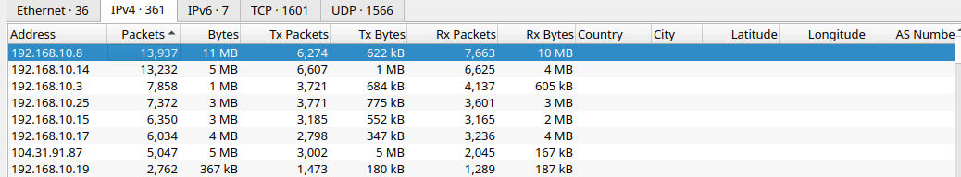
Phase 1: Detection
WireShark: Statistics -> endpoints
we see there is 2 ip addresses associated with high amounts of packets

Slide 5
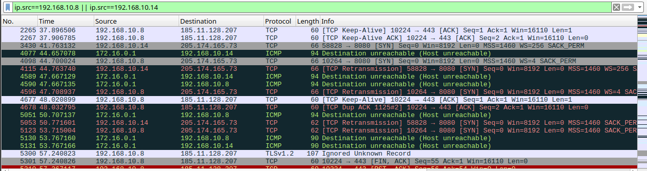
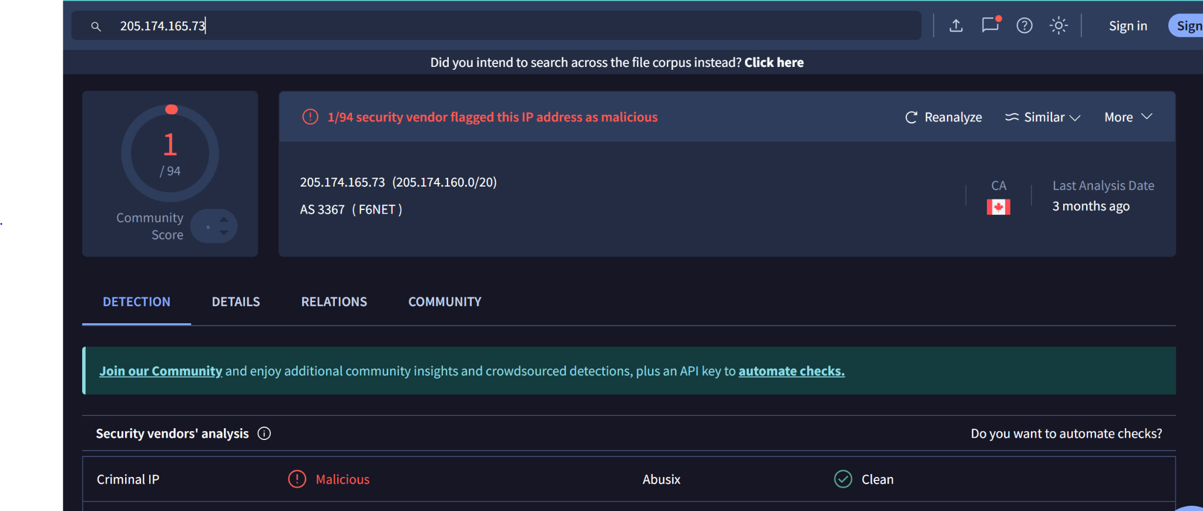
Notes:
Detection: constant TCP retransmissions to port 8080 — classic botnet/DDOS fingerprint

Slide 6
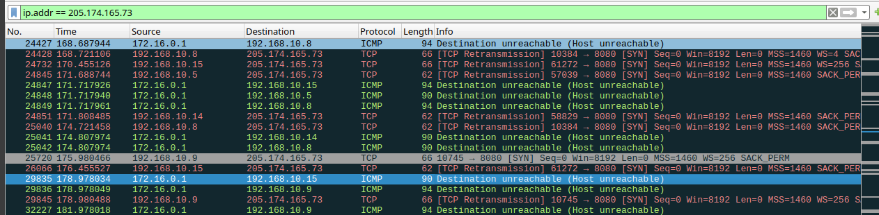
Phase 2: Analysis
TCP Retransmission (handshake not completed) is being sent multiple times to 5 different victims
Going through port 8080
Victims IP: 192.168.10.5, .8, .9, .15, .14
Attacker: 205.174.165.73
Notes:
Botnet ARES,

Slide 7
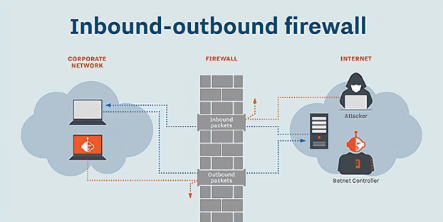
Phase 3: Preventing the attack
Block outbound access from the victim IP addresses to 205.174.165.73 on the company firewall or proxy
Add the malicious IP to a blocklist or threat intel feed
Enterprise Cybersecurity Solutions | Comcast Business

Slide 8
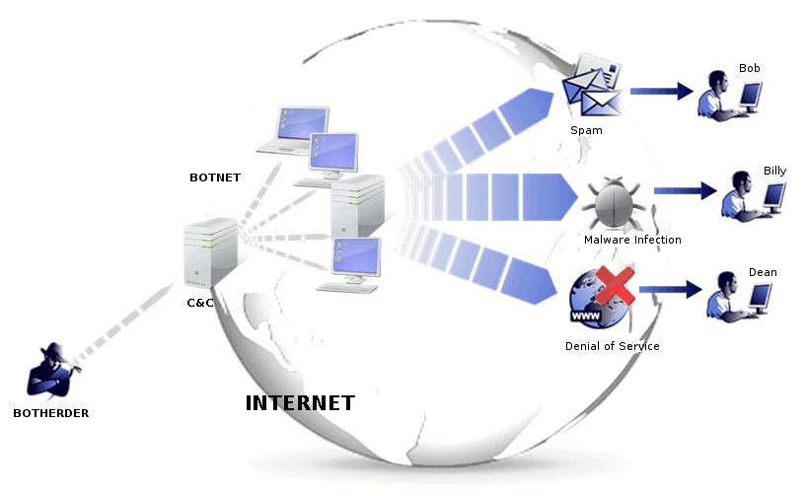

Phase 4: Eradication / Recovery
Check for stealthy ways an attacker can stay on the machines (scripts set on autoruns scheduled tasks)
Scan the systems for botnet malware
possible created or compromised accounts
Kill C2 connections (prevent remote access)
Allow traffic from affected systems slowly and monitor in Wireshark
Ensure systems no longer reach out to C2 IPs (205.174.165.73)

Slide 9
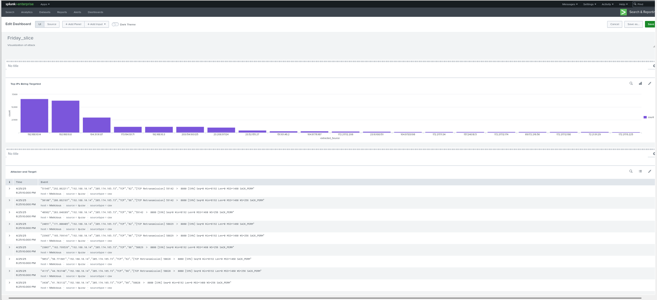
Phase 6: Lessons Learned / Reporting
Show pic
Artifacts, reports, ips, etc
.14 .8
Notes:
Investigation was triggered by high packets and multiple TCP retransmissions attempts

Slide 10
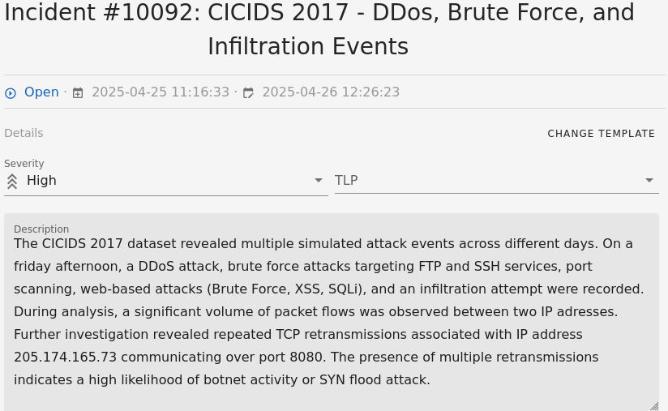
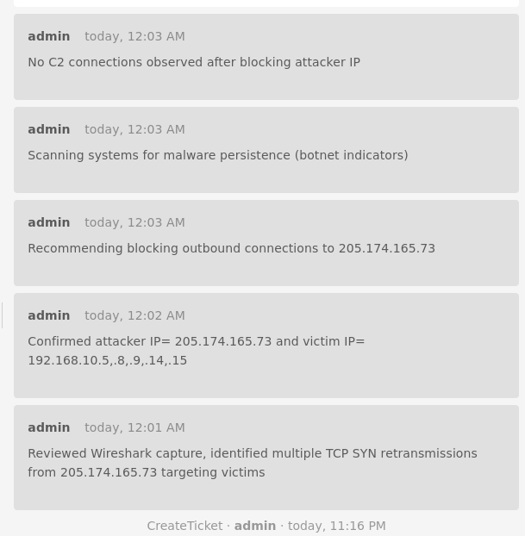
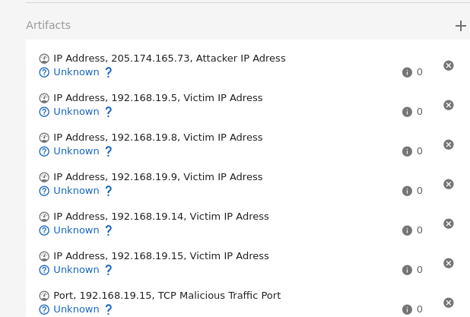
Catalyst Report
Notes:
Attacker IP: 205.174.165.73 on port 8080
The possible DDoS / botnet method likely SYN flood or C2 callback (where attacker gains remote access)
Host involved 192.168.10.14 , .8, 9, .5, .15

Slide 11
References
Canadian Institute for Cybersecurity. Index of /CICDataset/CIC-IDS-2017/Dataset. University of New Brunswick. Accessed 25 Apr. 2025. http://205.174.165.80/CICDataset/CIC-IDS-2017/Dataset/.
Canadian Institute for Cybersecurity. IDS 2017 | Datasets | Research. University of New Brunswick, 2017. Accessed 25 Apr. 2025. https://www.unb.ca/cic/datasets/ids-2017.html.
DDoS Incident Response Workflow. IncidentResponse.com. Accessed 25 Apr. 2025. https://incidentresponse.com/mini-sites/workflows/download/DDoS.pdf.
VirusTotal. IP Address Report: 205.174.165.73. VirusTotal, Google, Accessed 25 Apr. 2025. https://www.virustotal.com/gui/ip-address/205.174.165.73.

